Slide 1


SOFTWARE ENGINEERING (Week-2)
Usama Musharaf
Lecturer (Department of Computer Science)
FAST-NUCES Peshawar

Slide 2
Contents of week # 2
Agile Development (Cont…)
Scrum
DevOps
Quiz
Software Quality Engineering
Quality Engineering Economics
Quality Attributes
Quality Models

Slide 3
SCRUM
Scrum is an Agile framework for completing complex projects.
Scrum originally was formalized for software development projects, but it works well for any complex, innovative scope of work.
Scrum is a team-based approach, to iteratively, incrementally develop systems and products.
when requirements are rapidly changing .

Slide 4
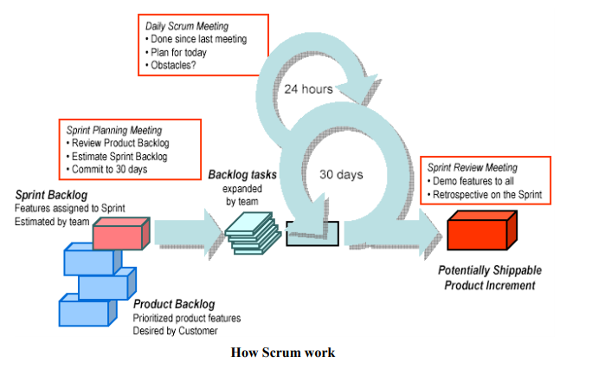
How does SCRUM work?

Slide 5
User Stories
User Story capture 3 important items
Who
What
Why
User Story Format
As a (user or type of user)
I want a (some goal or what)
So that ( I can achieve some value or why)

Slide 6
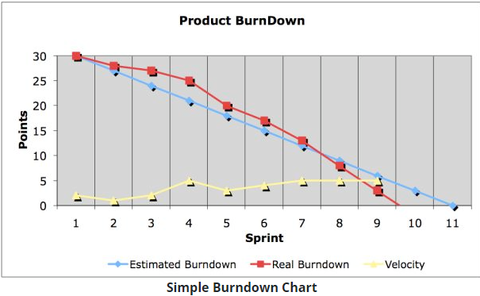
Burndown chart

Slide 7
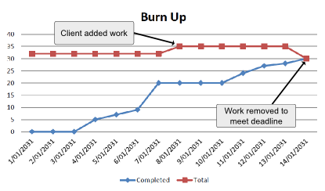
Burn up chart

Slide 8
DevOps

Slide 9
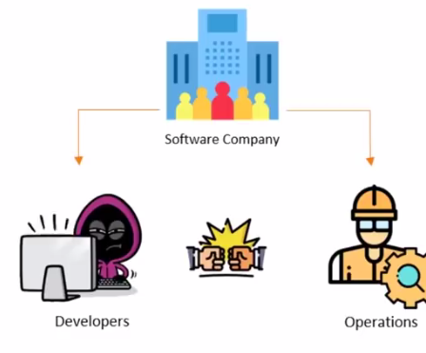

Devops

Slide 10
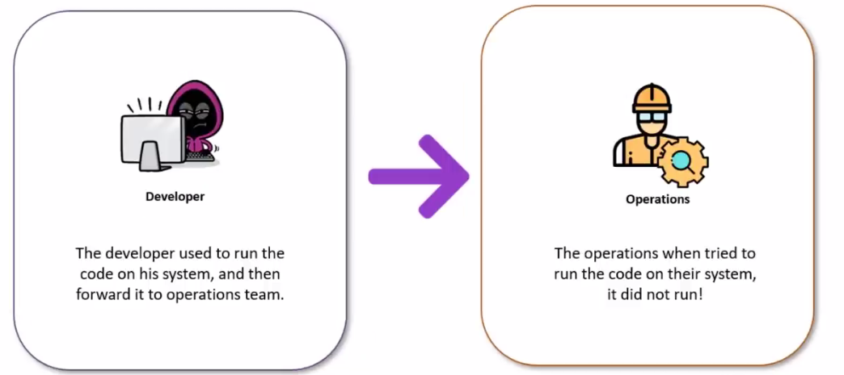
Why Devops

Slide 11
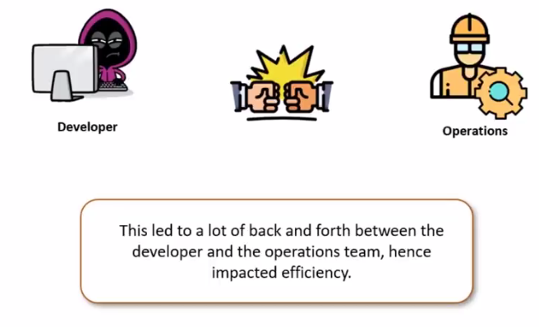
Why Devops

Slide 12
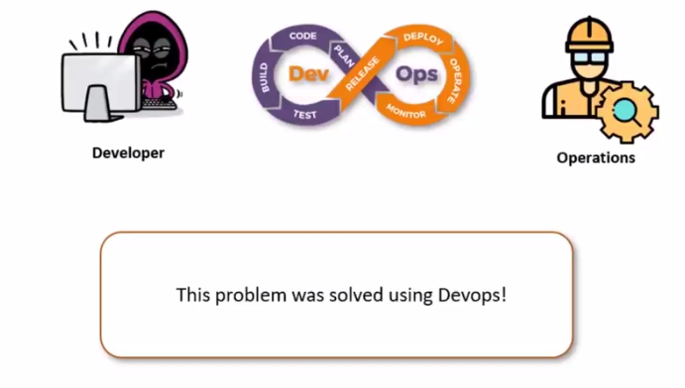
Why Devops

Slide 13
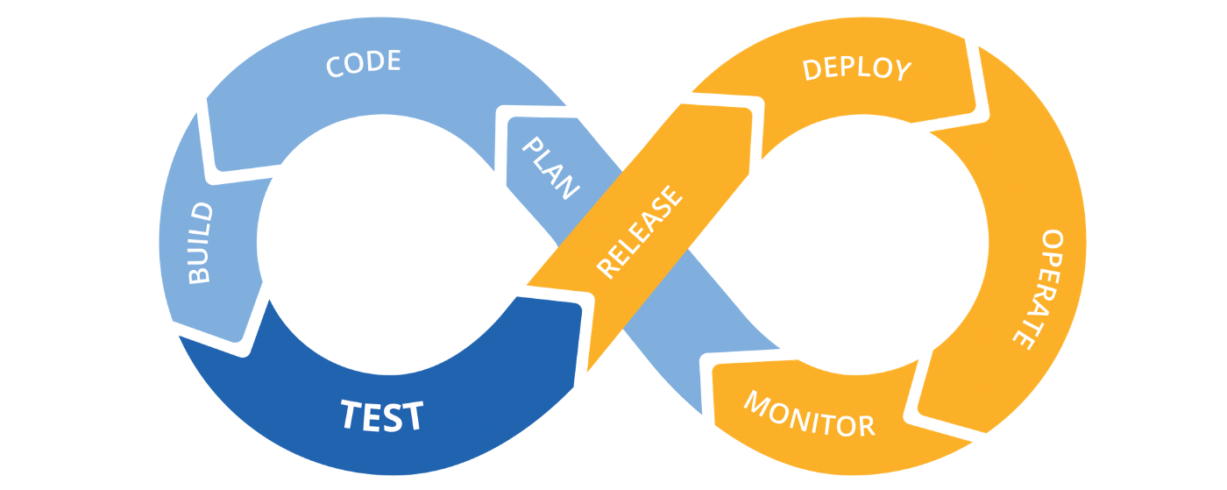
Devops
What is DevOps
DevOps assimilates development and operations teams to improve the collaboration process.
A DevOps Engineer will work with IT developers to facilitate better coordination among operations, development, and testing functions by automating and streamlining the integration and deployment processes.

Slide 14
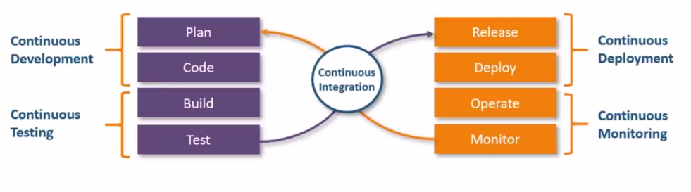
How Devops Work
The DevOps life cycle divides the SDLC into the following stages.

Slide 15
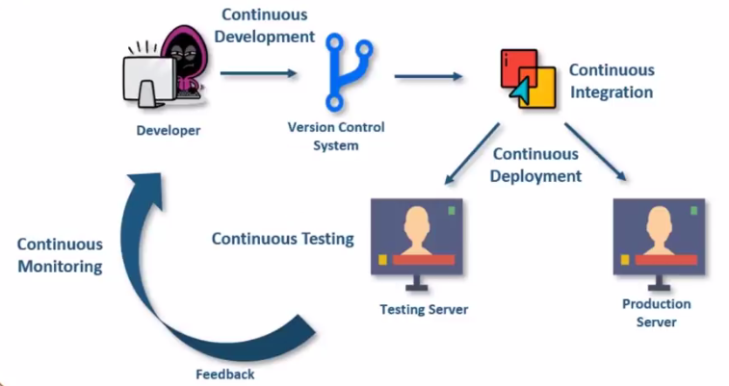
How Devops Work

Slide 16
Software Quality Engineering

Slide 17
What is Software Quality ?
According to the IEEE
Software quality is:
The degree to which a system, component, or process meets specified requirements.
The degree to which a system, component, or process meets customer or user needs or expectations.

Slide 18
What is Software Quality?
“Achieving high levels of user satisfaction, portability, maintainability, robustness, and fitness for use” by Dr. Barry Boehm.
Quality means “conformance to user requirements” by Phil Crosby.
Edwards Deming considers quality to be “striving for excellence” in reliability and functions by continuous improvement in the process of development, support by statistical analysis of the causes of failure.

Slide 19
What is Software Quality?
Watts Humphrey, of the SEI, tends to speak of quality as “achieving excellent levels of fitness for use, conformance to requirements, reliability and maintainability.”
James Martin said that software quality means being on time, within budget and meeting user needs.
Tom McCabe, the software complexity specialist, defines quality as “high level of user satisfaction and low defect levels, often associated with low complexity.

Slide 20
What is Software Quality?
John Musa of Bell Laboratories states that quality means combination of “low defect levels, adherence of software functions to users needs, and high reliability”
Bill Perry, head of Quality Assurance Institute has defined quality as “high levels of user satisfaction and adherence to requirements”.

Slide 21
Importance of Software Quality
Software is a major component of computer systems
(about 80% of the cost)
– used for
– communication (e.g. phone system, email system)
– health monitoring,
– transportation (e.g. automobile, aeronautics),
– economic exchanges (e.g. ecommerce),
– entertainment,
– etc.
Software defects are extremely costly in term of
– money
– reputation
– loss of life

Slide 22
What is Software Quality Assurance?
According to the IEEE
Software quality assurance is:
A planned and systematic pattern of all actions necessary to provide adequate confidence that an item or product conforms to established technical requirements.
A set of activities designed to evaluate the process by which the products are developed or manufactured. Contrast with: quality control.

Slide 23
What is Software Quality Assurance?
According to D. Galin
Software quality assurance is:
“A systematic, planned set of actions necessary to provide adequate confidence that the software development process or the maintenance process of a software system product conforms to established functional technical requirements as well as with the managerial requirements of keeping the schedule and operating within the budgetary confines.”

Slide 24
Software Quality Challenges
Quality cannot be directly checked in the product; it must planned right from the beginning.
The project must focus on the quality issues of the project from the beginning, ensuring that quality criteria are consistent with defined requirements.
Quality means meeting requirements and meeting customer needs, which means a defect-free product from both the producer’s and the customer’s viewpoint.

Slide 25
Software Quality Engineering Road Map
Quality Engineering at every SDLC phase:
Quality Engineering
Requirement Analysis
Quality Attributes
Design
Version Controlling
GIT, GIT Hub
Code
Unit Testing
(JUnit)
Testing
Docker Containers
Defects
Deployment

Slide 26
What is an Error?
Error is usually refer to some syntax mistake by developer.
Refer to both Syntax and semantic error.
Syntax error are usually fixed by developer.
Semantic error give rise to unusual output.

Slide 27
What is Defect?
Defect is deviation from customer requirement.
Mostly defects are found in the software after software is shipped to the customer at production site.
Example:
In online shopping, the option of searching a debit card for making payment is missing.

Slide 28
What is Bug?
Error found before the software is shipped into production.
“Defects” accepted by developers are bugs.

Slide 29
What is Fault?
Fault is a result of error.
Fault is an incorrect step or process due to which unanticipated result arises.

Slide 30
What is Failure?
Failure is a result of faults.
Failure is inability of the program to behave as expected within given performance requirement.

Slide 31
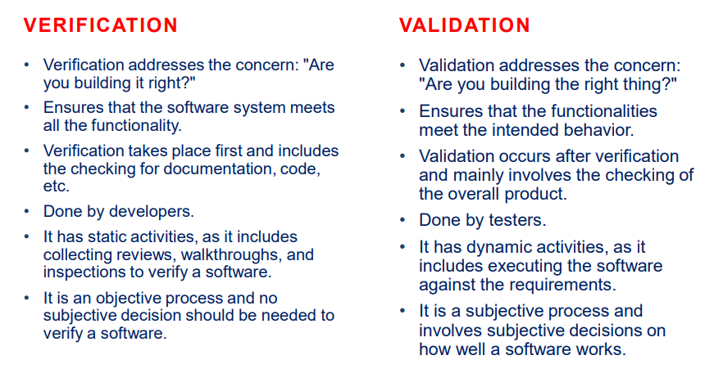

Slide 32
Quality Engineering Economics
High concerns and challenges in the software quality engineering, one must realize the following facts in order to cope with the quality task:
Everything in the process of software development ends up in the user’s satisfaction.
Satisfaction of the user is dependent on the overall behavior of the system.
Features and quality of the software product are defined/determined through requirements.

Slide 33
Function Quality Cost (FQC)
In most development projects, functionality and quality ( QA precisely) are natural enemies.
Projects with open budgets are very rare, usually the budget is fixed and here the functionality and quality compete with each other in order to get a bigger share from budget.
The Function-Quality-Cost comes out to be
Cost = AF + BQ
Where A & B = Level of investment
F = Features/Functions
Q = Quality

Slide 34
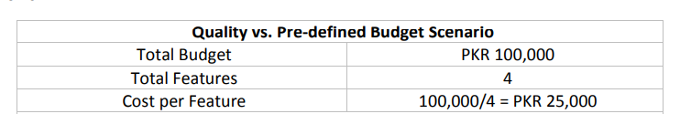
Function Quality Cost (FQC)
It is very much clear that increasing feature in a closed-budget project will certainly decrease the budget share for quality of the product.
The following example will elaborate the concept more clearly.
(Dev + QA)

Slide 35
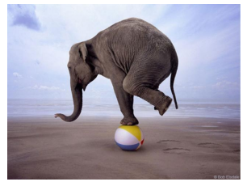
Quality attributes
Quality attributes depend on each other.
It is impossible to completely satisfy all quality attributes of a software system.

Slide 36
SOFTWARE QUALITY MODELS
Quality is the excellence of the product or service.
From a user’s point of view, quality is ‘fitness for purpose’.
From the manufacturing point of view, the quality of a product is the conformance to specification.

Slide 37
Hierarchical models
McCall divided software quality attributes into 3 groups.
Each group represents the quality with respect to one aspect of the software system while the attributes in the group contribute to that aspect.
Each quality attribute is defined by a question so that the quality of the software system can be assessed by answering the question.

Slide 38
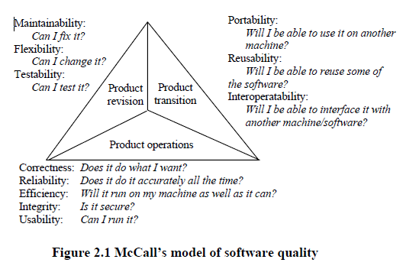

Slide 39
Relational models
Perry’s model contains three types of relationship between the quality attributes.
The direct relationship
The inverse relationship
The neutral relationship

Slide 40
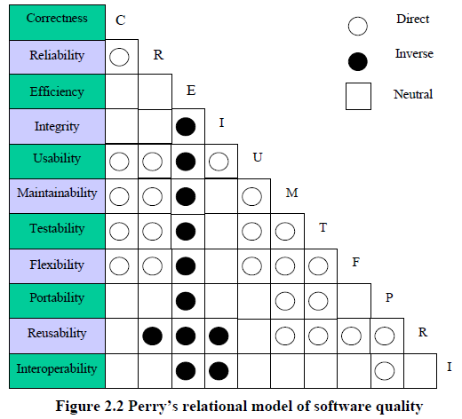

Slide 41
Relationship b/w quality attributes
Integrity vs. efficiency (inverse):
The control of data access will need additional code, leading to a longer runtime and more storage requirement.
Usability vs. efficiency (inverse):
Improvement of HCI will need more code and data, hence the system will be less efficient.

Slide 42
Relationship b/w quality attributes
Maintainability and testability vs. efficiency (inverse):
Compact and optimized code is not easy to maintain and test.
Flexibility, reusability vs. integrity (inverse):
Flexible data structures required for flexible and reusable software increase the data security problem.
Reusability vs. maintainability (direct):

Slide 43
Relationship b/w quality attributes
Portability vs. reusability (direct):
Portable code is likely to be easily used in other environments. The code is likely well-structured and easier to be reused.
Correctness vs. efficiency (neutral):
The correctness of code has no relation with its efficiency. Correct code may be efficient or inefficient in operation.

Slide 44
HAVE A GOOD DAY!

